Slide 1

GLOBAL WEB STRATEGY
Global Web Programs
March, 2009

Slide 2
Start at the Beginning

Slide 3
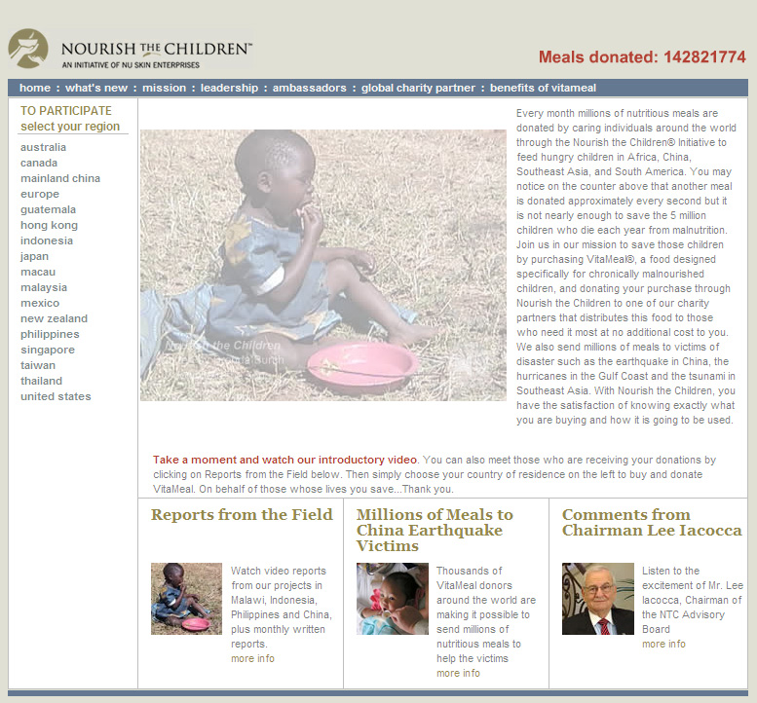


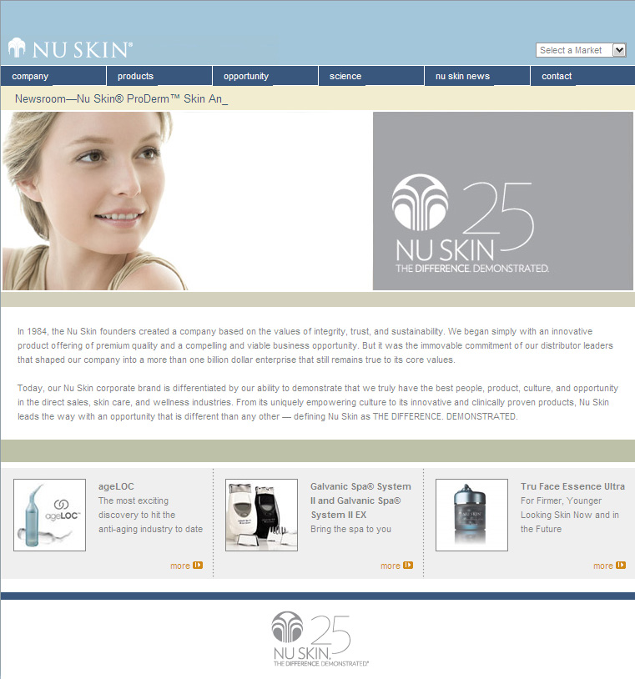



Slide 4
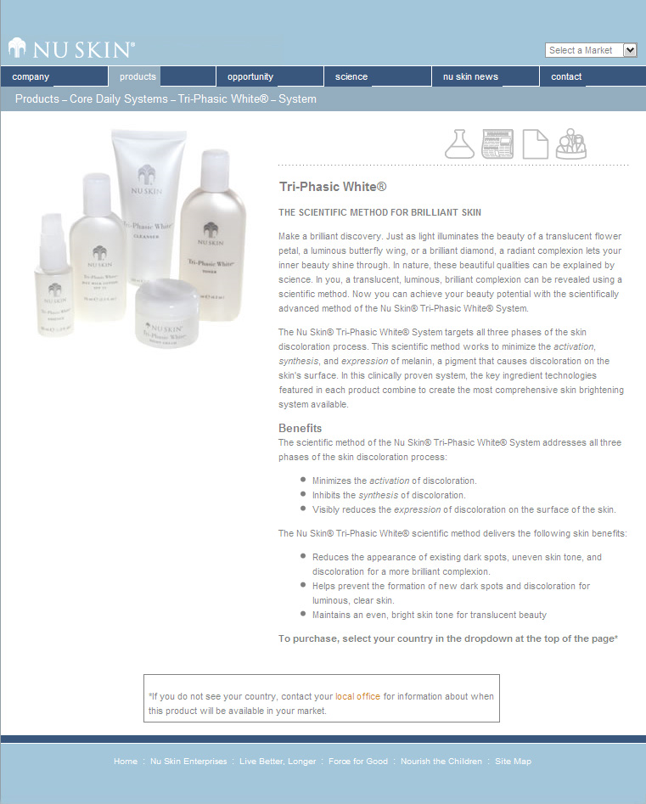

Slide 5
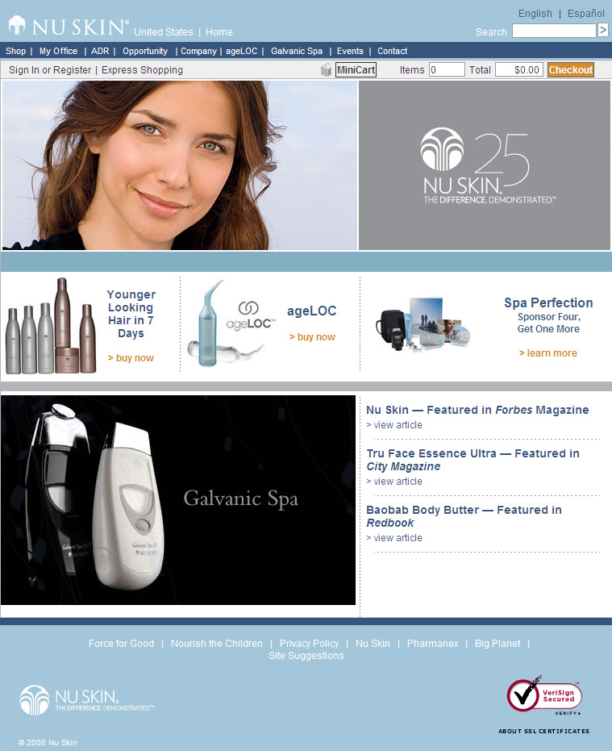




Slide 6
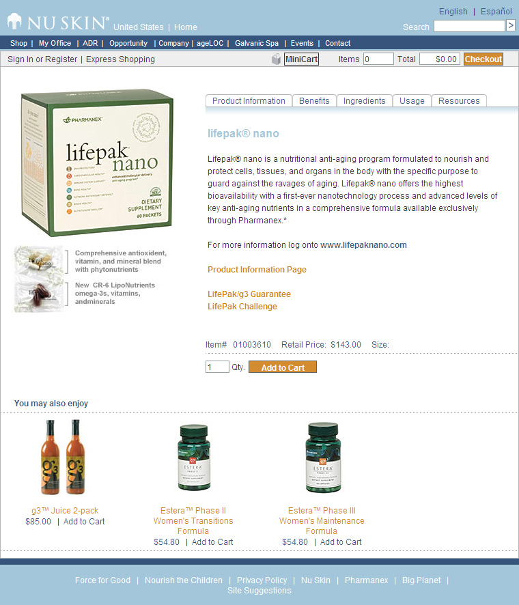

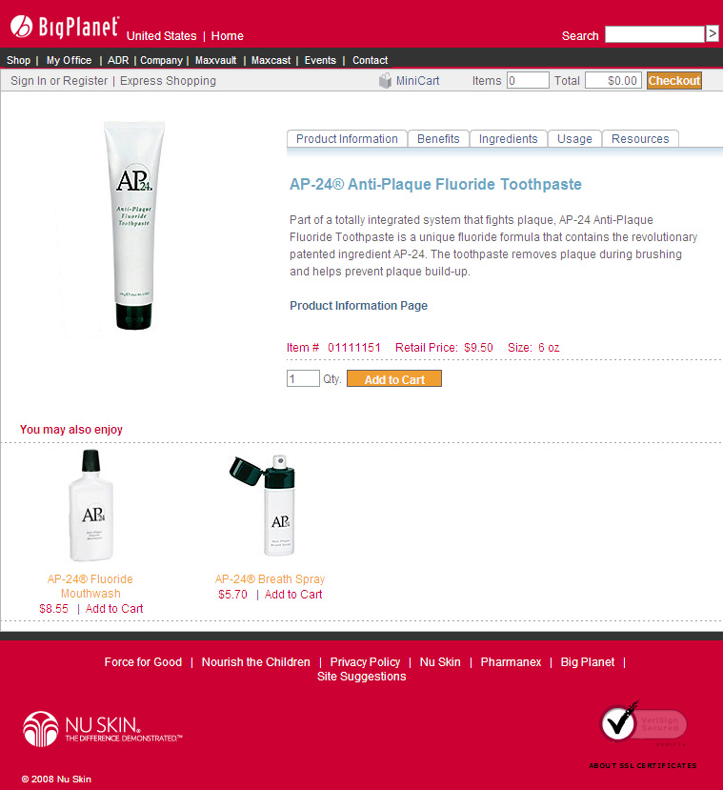

Slide 7
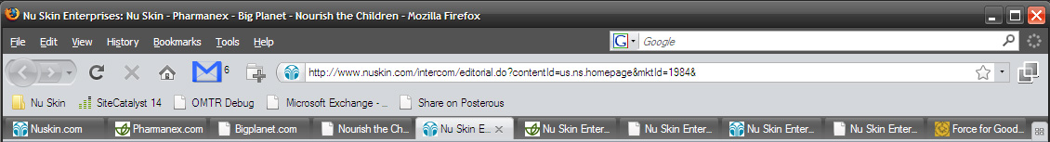

Slide 8
Word on the Street
“The impression I get when hitting our "front page" main sites is that they are trying to do too many roles at once.”
“Currently it seems somewhat ‘clunky’ for lack of a better way to describe it. Like someone pasted together two completely different looking websites. It would be great to see a nice high end professional theme.”
You need liquid width webpages. Have you had any thoughts about “widening” the pages for the NSE websites. Most monitors today are widescreen.
“Information needs to be more available - I cannot figure out how to find it. Can you please make this easier to find on the website?”

Slide 9
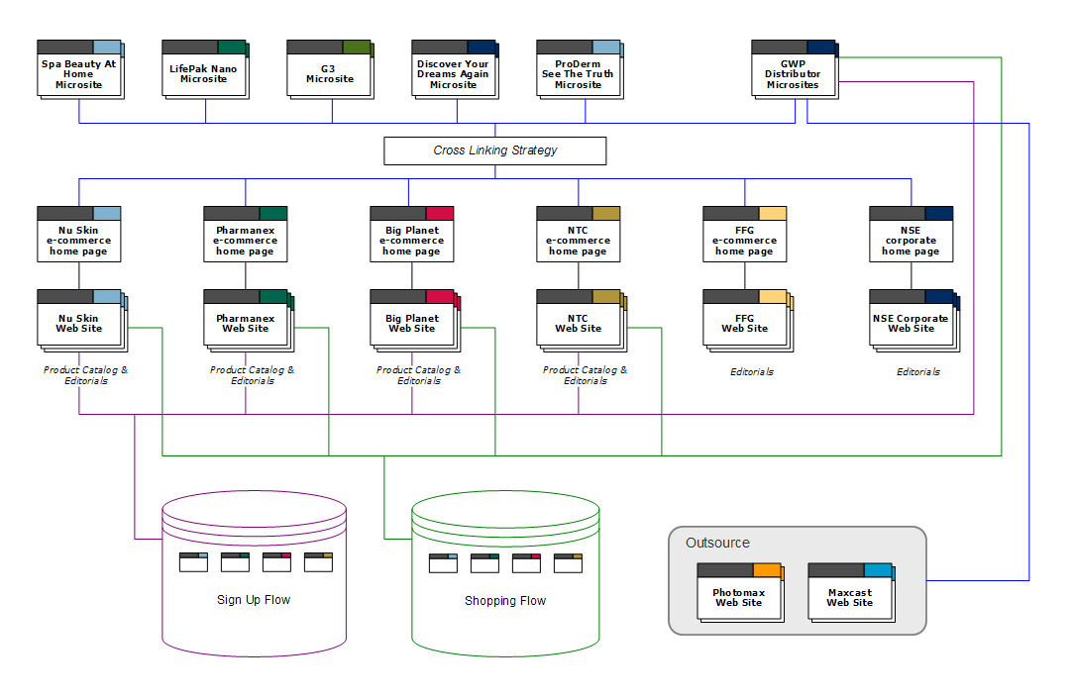

Slide 10


Slide 11


IDEAS
ONLINE EXPERIENCE
Vision
Strategy
Roadmap
Story
Voice
Brand
.com sites
microsites
online tools
online core functionality
distributor sites

Slide 12
IDEAS
ONLINE EXPERIENCE
Technical Architecture
Development Environment
Web Metrics
Code

Slide 13
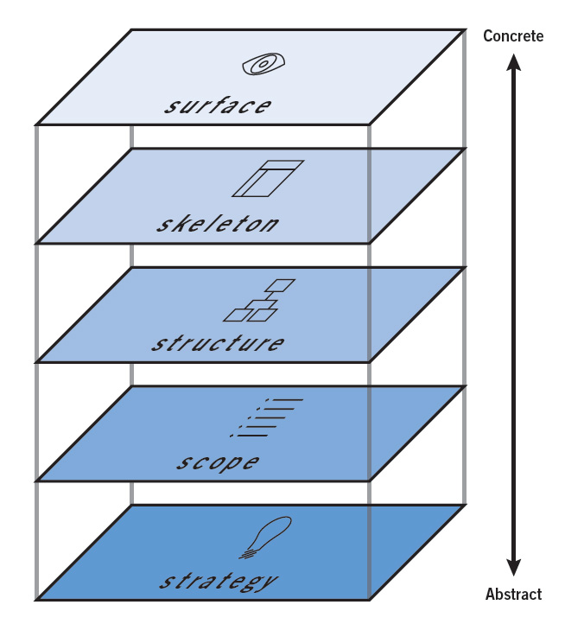
Surface brings everything together visually: What will the finished product look like?
Skeleton makes structure concrete: What components will enable people to use the site?
Structure gives shape to scope: How will the pieces of the site fit together and behave?
Scope transforms strategy into requirements: What features will the site need to include?
Strategy is where it all begins: What do we want to get out of the site? What do our users want?

Slide 14


Slide 15
IDEAS
ONLINE EXPERIENCE
Technical Architecture
Development Environment
Web Metrics
Code

Slide 16

IDEAS
ONLINE EXPERIENCE
Vision
Strategy
Roadmap
Story
Voice
Brand
.com sites
microsites
online tools
online core functionality
distributor sites

Slide 17
IDEAS
ONLINE EXPERIENCE
Web Content Management System
Web Digital Asset Mgmt
User Experience
IxD
Online Editorial Content Facilitation
Web Metrics
IA

Slide 18
The Strategy

Slide 19


Focus our internet investments by developing a global internet strategy that will support business growth by increasing sponsor rate, reducing lapse rate and increasing order volume.

Slide 20

To improve and enhance communication with our distributors.

Slide 21

To drive sales through a cost-effective channel.

Slide 22

Leverage the internet

Slide 23




Slide 24

Corporate and Market Web Structure
NSE
Homepage
Nu Skin
Homepage
Pharmanex
Homepage
Big Planet
Homepage
NTC
Homepage
FFG
Homepage
Market websites
260 websites (driven by language and brand division)
5 global technical architecture platforms
Code variations – leads to complexity
No enterprise content management system
Business processes are not aligned

Slide 25
What’s the problem?

Slide 26

Complex system of URLs and functionality

Slide 27

Difficult to search

Slide 28

Navigation is difficult and inconsistent

Slide 29

Loss in confidence in order handling

Slide 30

Inconsistent overall user experience

Slide 31

Distributor web pages not connected to overall web strategy

Slide 32

The web can only take so many layers of “paint”.

Slide 33

The Solution
Microsites
Nu Skin
Homepage
GWP
Select country and language
Prospect
Sign-up
Shop
Setup GWP
Customer
Sign-up
Shop
Owner/ Downline
My Office
V&G
Shop
Market Information
Lead Generator
Market homepages use same design as www.nuskin.com
Market
Homepages
(260 drops to 87)
Market websites
260 websites (driven by language and brand division)

Slide 34

Simplify the online experience by reducing web properties.

Slide 35

Communicate a strong, compelling opportunity and product story.

Slide 36

Increase resource efficiency within IT with improved and consolidated systems.

Slide 37

Maximize the effectiveness of aligned business programs.

Slide 38

Differentiate ourselves from the competition.

Slide 39
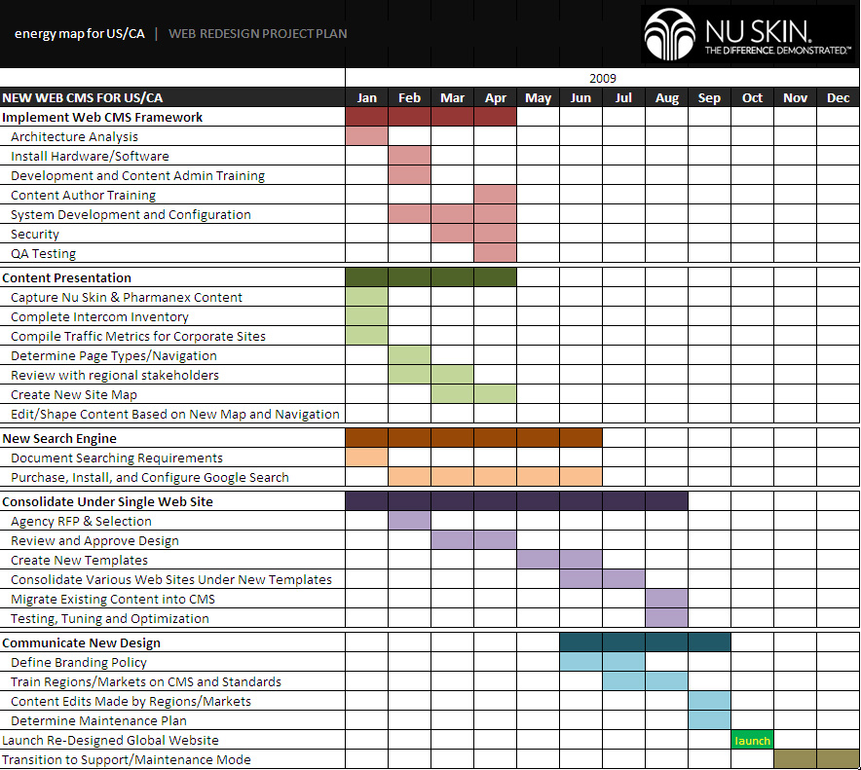

Slide 40

THANK YOU

Slide 41

Increase sales and value by funneling eCommerce, MyOffice, and sponsoring functions to GWP.

Slide 42
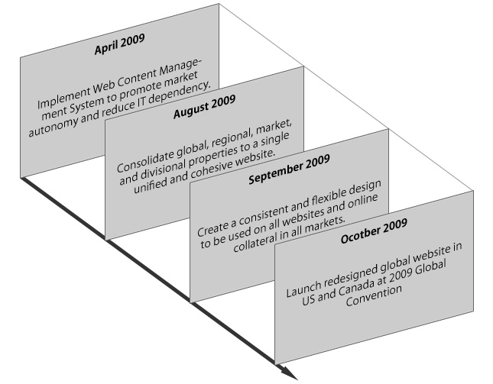
Next Steps

Slide 43
POTENTIAL AUDIENCES
Distributors (as defined by segmentation)
Leaders (Gold and above)
New recruits (LOI and above)
Prospects
Customers
Preferred
Retail
Media/Investors

Slide 44
Proposal Impact
Improve communication with distributors:
Simplify online experience by reducing web properties from 260 to 87.
Communicate a strong, compelling opportunity and product story via microsites and market autonomy.
Drive sales through a cost-effective channel:
Increase sales and value by funneling eCommerce, MyOffice, and sponsoring functions to GWP.
Increase resource efficiency within IT with improved and consolidated systems.
Leverage the Internet:
Maximize effectiveness of aligned business programs (Sign-up, ADR, and GWP).
Differentiate ourselves from the competition with the best online user experience in the industry.

Slide 45
AUDIENCES
www.nuskin.com
Media/ Investors
Search Engine sources
www.nuskin.com/country
New customer
Regulatory bodies
Local media
www.nathen.nsedreams.com
prospects (Distributor/ Customer)
Existing distributors/ customers
Owner
Micro-sites
prospects (Distributor/ Customer)

Slide 46
The Problem
Complex system of URLs and functionality
Difficult to search
Difficult and inconsistent navigation
Loss in confidence in order handling
Inconsistent overall user experience
Distributor Web Pages not connected overall web strategy

Slide 47
STRATEGIC PURPOSE
To improve and enhance communication with our distributors
To drive sales through a cost-effective channel
To leverage the internet to:
Add value to the GWP
Enhance the online user experience
Create level of professionalism for our distributors to promote the business
Maintain relevance in an ever increasing technologically advanced world
Differentiate ourselves from the competition

Slide 48
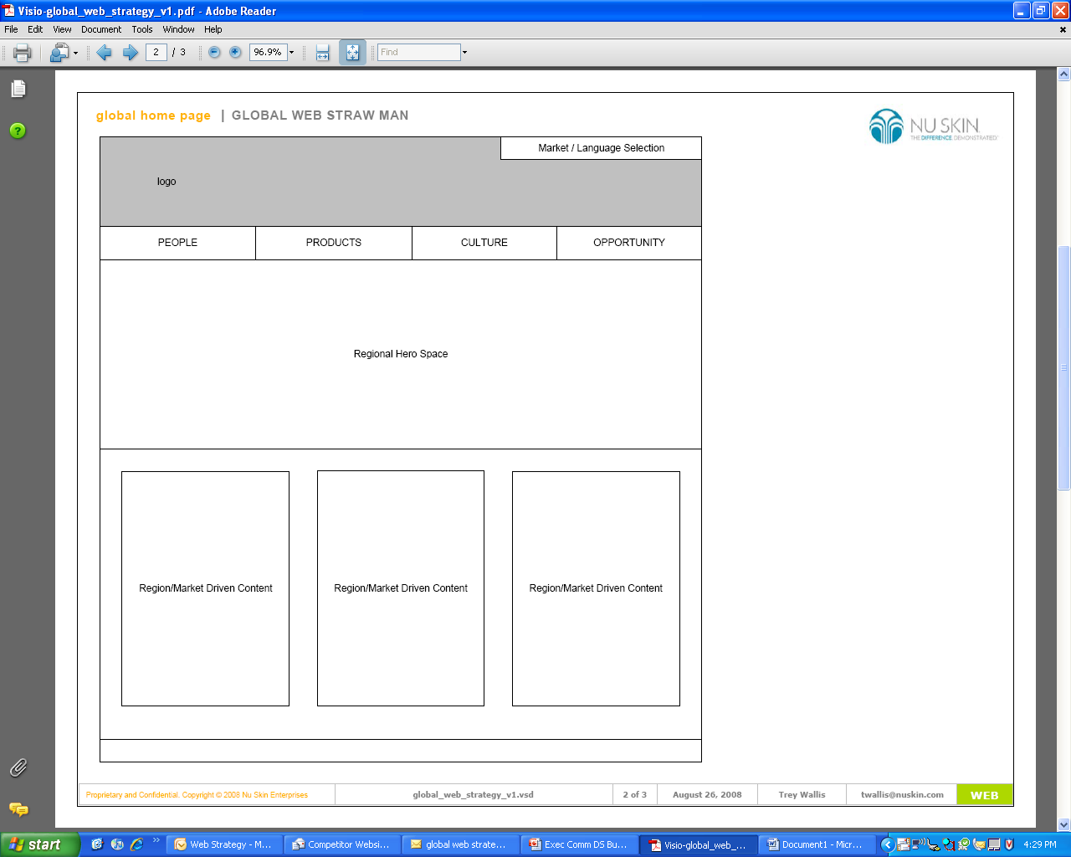
Homepage Strawman

Slide 49
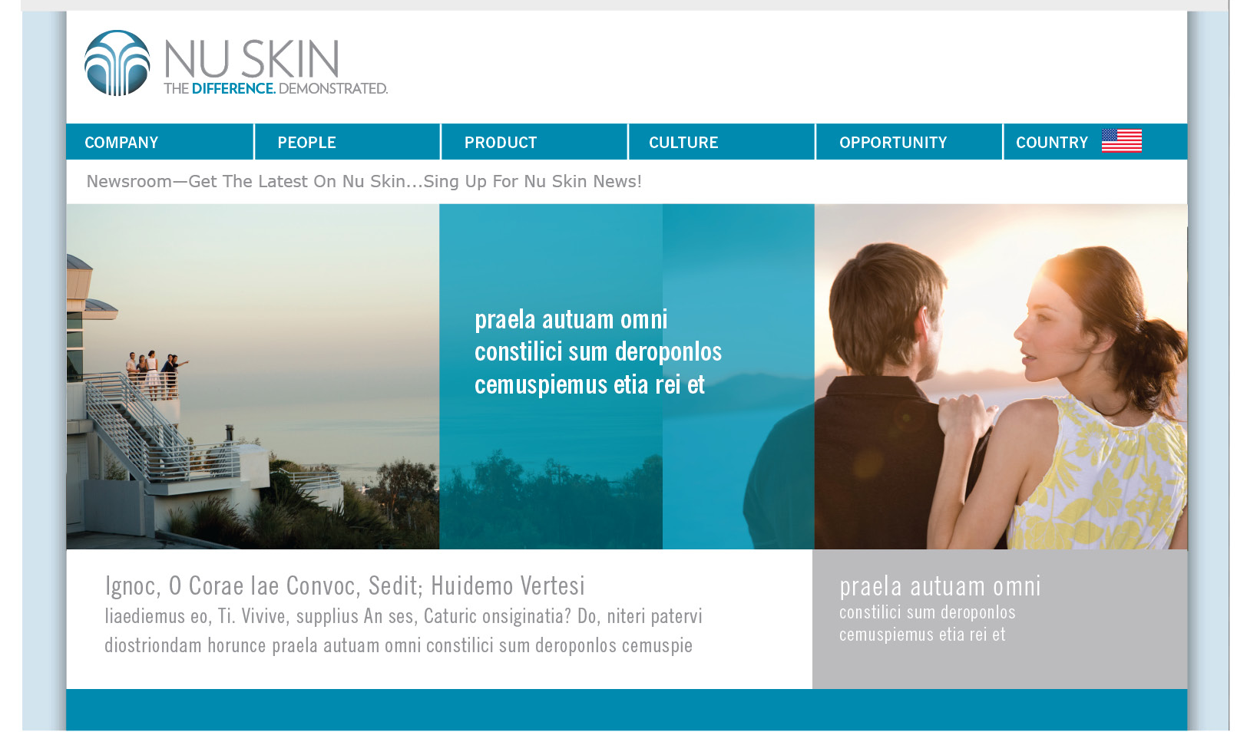
Navigation Simplification

Slide 50
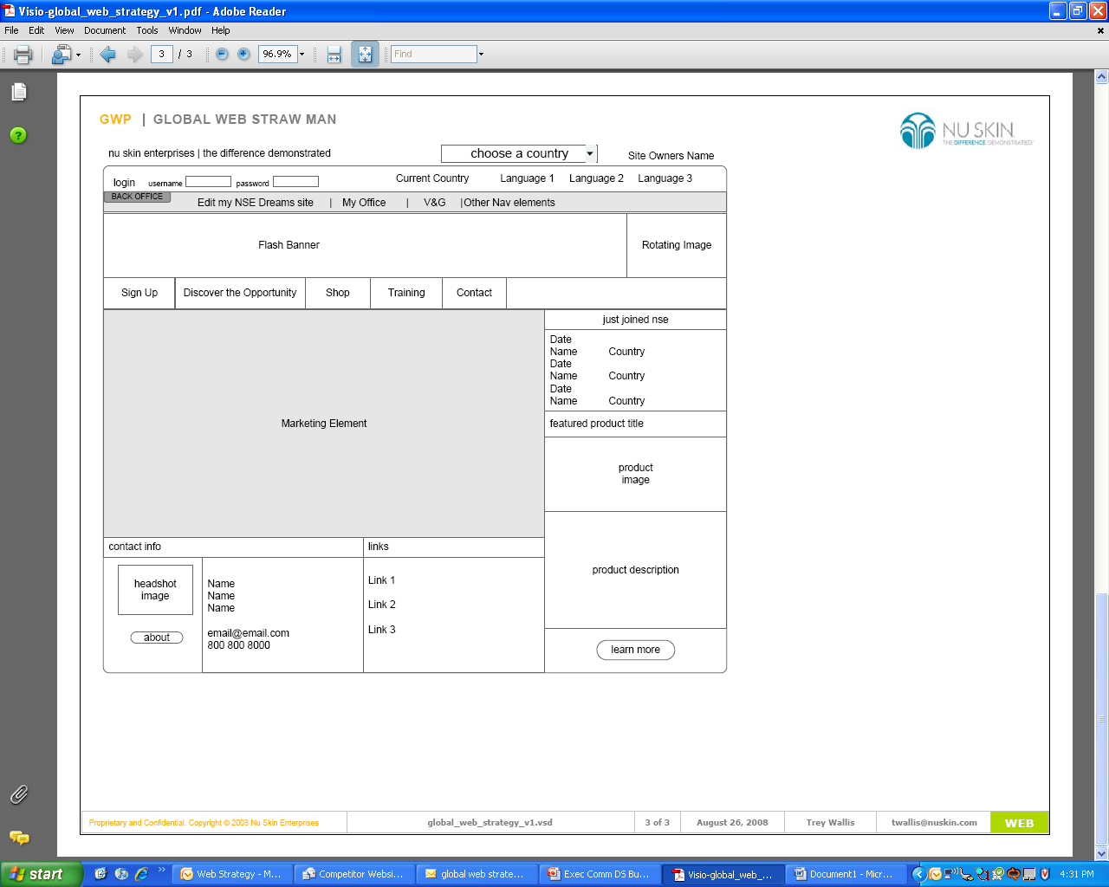
GWP Strawman

Slide 51
Proposal Benefits
Improve sponsorship
Improve lapse rate
Increase average order size
Improve communication
Provide cost effective channel for sales
Leverage internet

Slide 52
Next Steps
Implement systems that promote market autonomy and streamline productivity.
Create a consistent and flexible web design.
Consolidate web sites (260 to 87) and implement new design and information architecture.
Enhance user experience with improved search and business tools.

Slide 53

THANK YOU

